Slide 1

User Management System With OTP Authentication
In supervision of
PROF. MAMTA RANI
Dept. Computer Science
SUNIL SUWASIYA
2020IMSCS028

Slide 2

Introduction
Objectives
Technology used
FC of System
Result
Reference

Slide 3


Introduction
A user management website with OTP authentication is a secure and efficient way to manage user access to a system or application.
The website allows users to create accounts, update personal information, and manage their access permissions.
OTP authentication adds an additional layer of security to the login process by requiring users to enter a one-time code sent to their registered phone number or email address.

Slide 4

Secure user authentication: OTP authentication helps to ensure that only authorized users can access the system or application.
User account management: The website should allow users to create and manage their accounts.
To enhance knowledge in HTML , CSS , Node-js, JS , MYSQL

Slide 5




Technology used
5
HTML
Node Js
JavaScript
MySQL

Slide 6

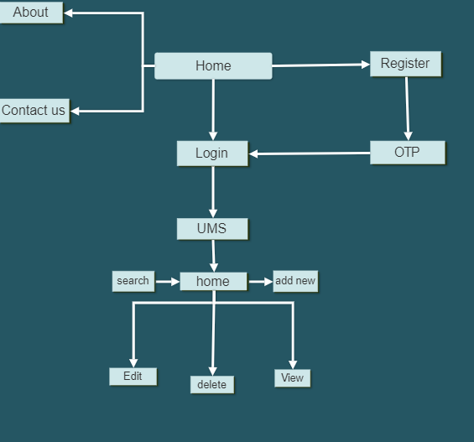
FC of the system

Slide 7
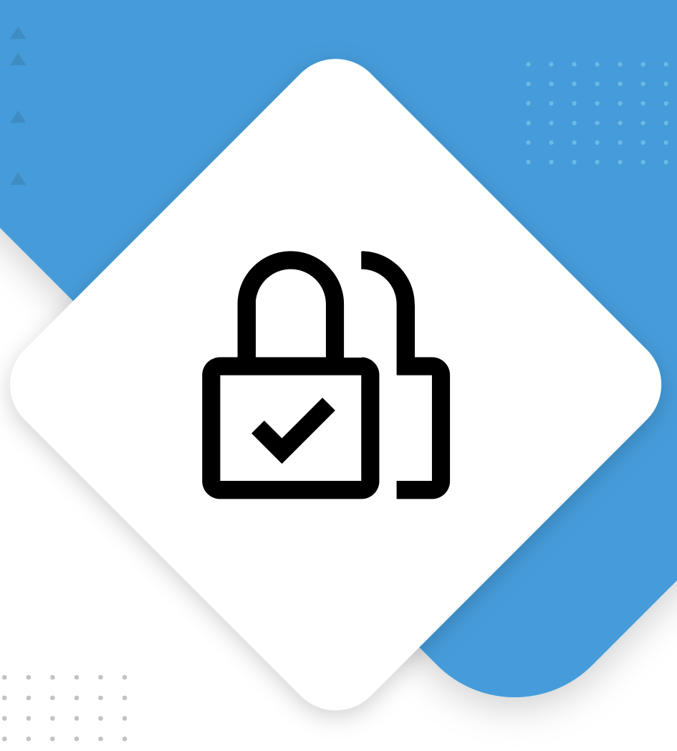
Result
A user management website with OTP authentication and a secure and efficient way to manage user to a system or application.

Slide 8
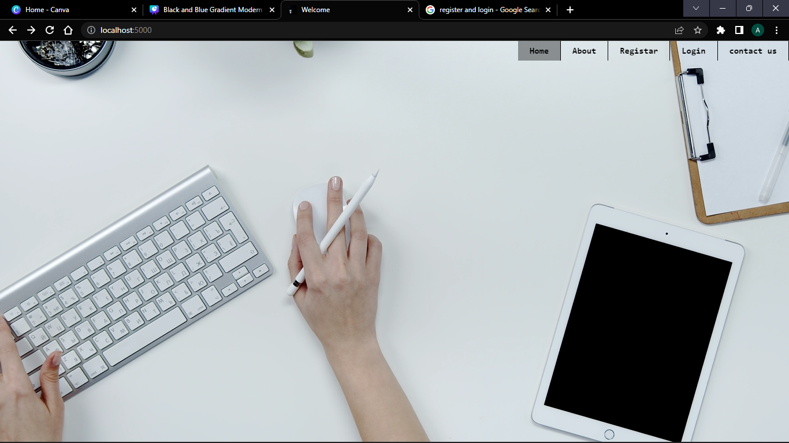
Timeline
PROMINENT PAGE:
8

Slide 9
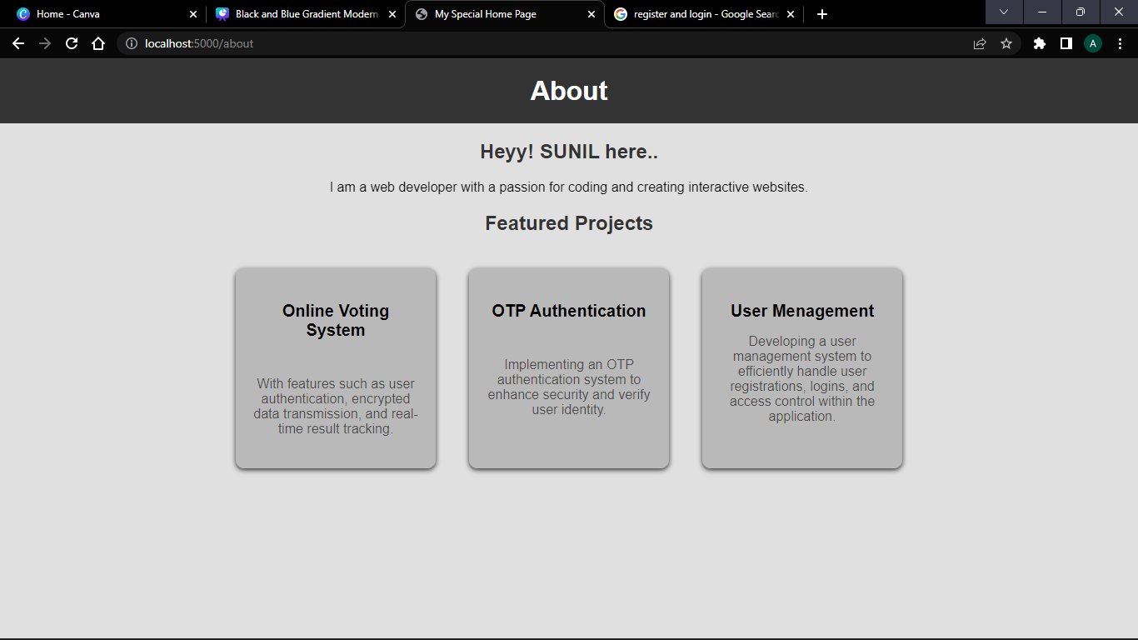
Timeline
ABOUT
9

Slide 10
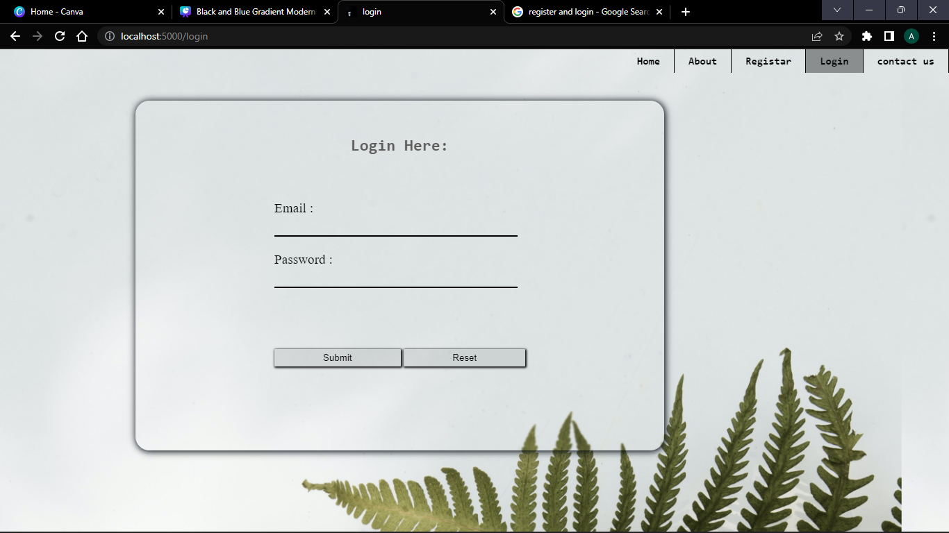
Timeline
LOGIN PAGE:
10

Slide 11
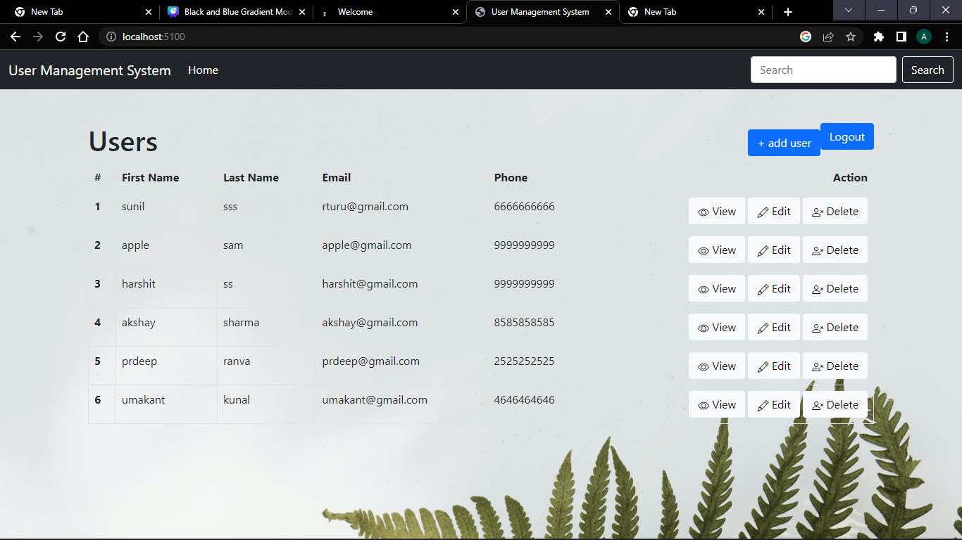
Timeline
User Management System
11

Slide 12

Reference:
Node Js Documentation
Internet Sources:

Slide 13

Thank you
2020IMSCS028
13

